Slide 1


Slide 2
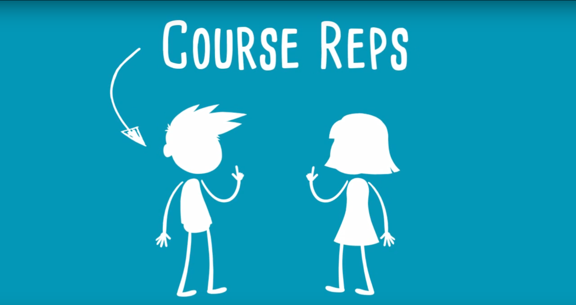
Course Reps are students who have been elected by their course mates.

Slide 3


Slide 4
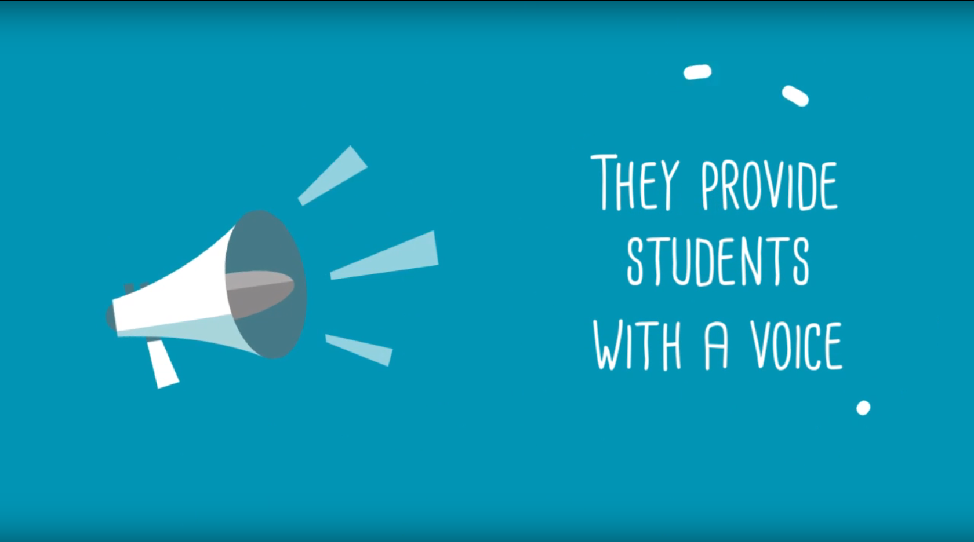
They ensure that University of Worcester students get the best education possible.

Slide 5
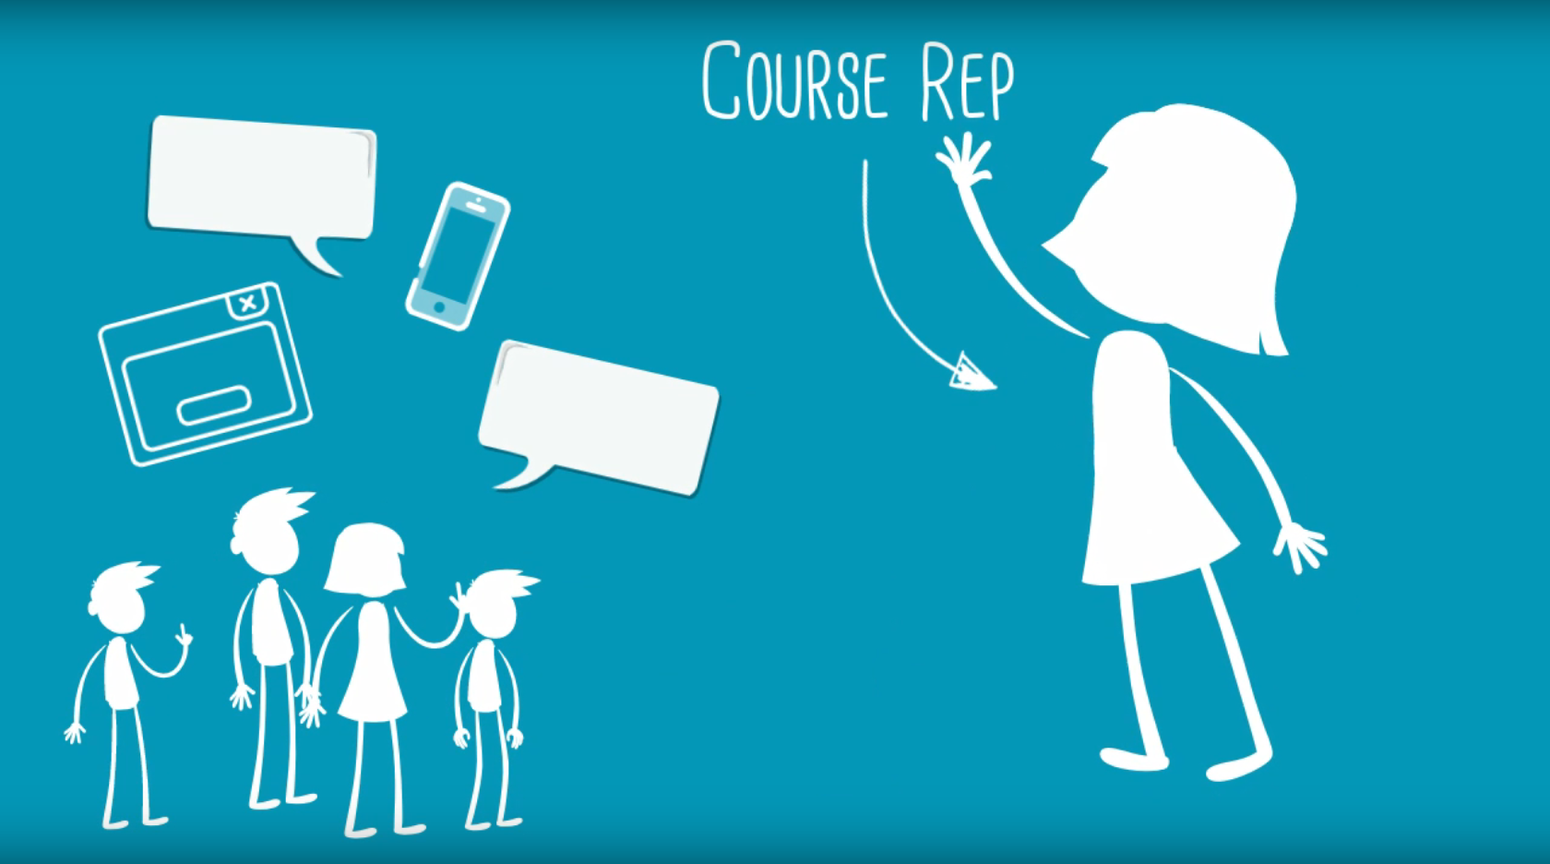
Course Reps gather their course mates’ views about various aspects of their studies and University life in general.

Slide 6
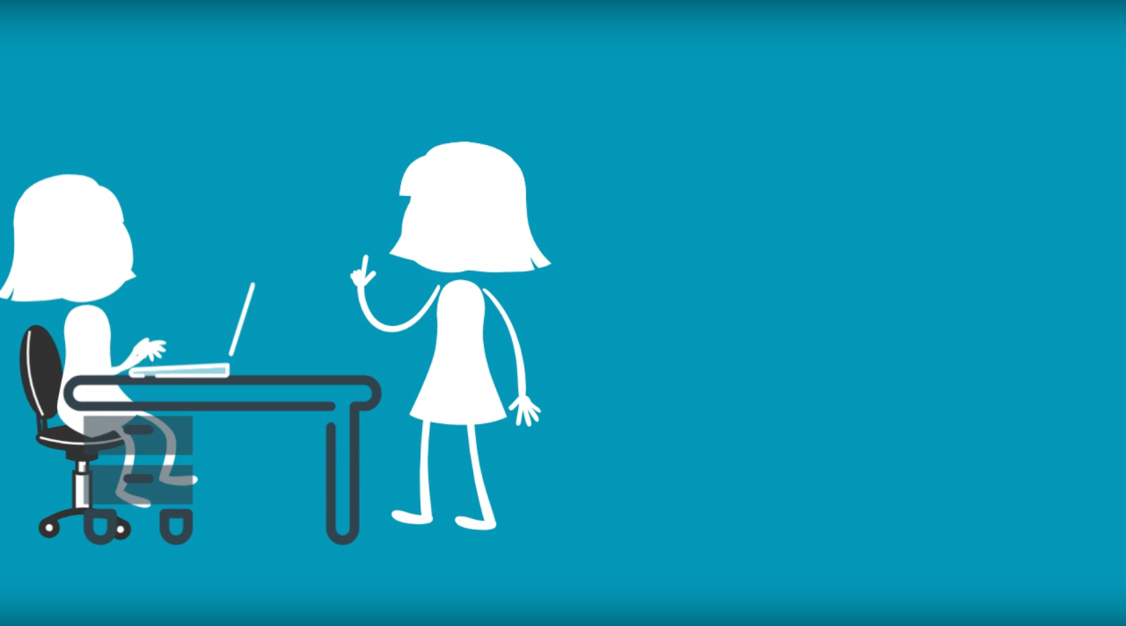
They communicate feedback to staff members, suggest solutions, and work together with staff to bring about change.

Slide 7
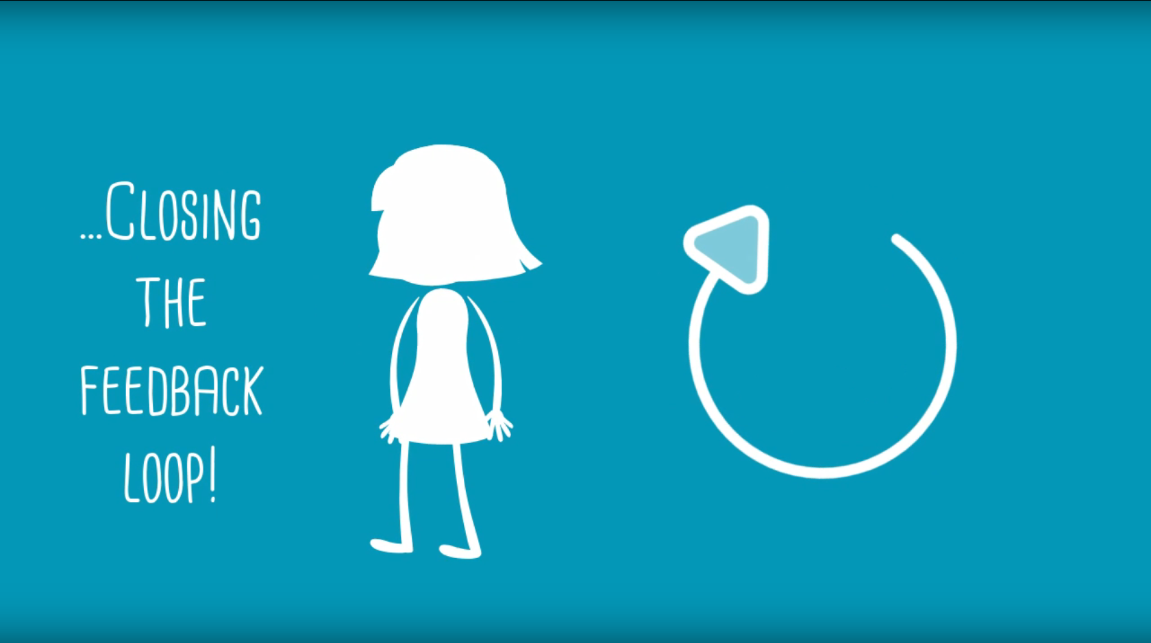
Course Reps also play an important role in closing the feedback loop by working with staff to ensure their course mates are aware of the impact their feedback has had.

Slide 8
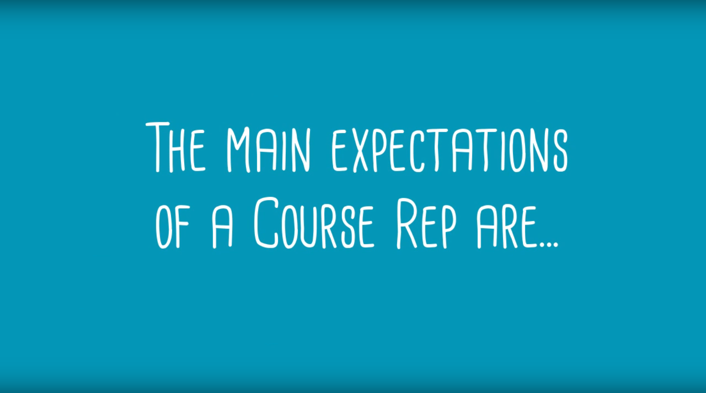

Slide 9
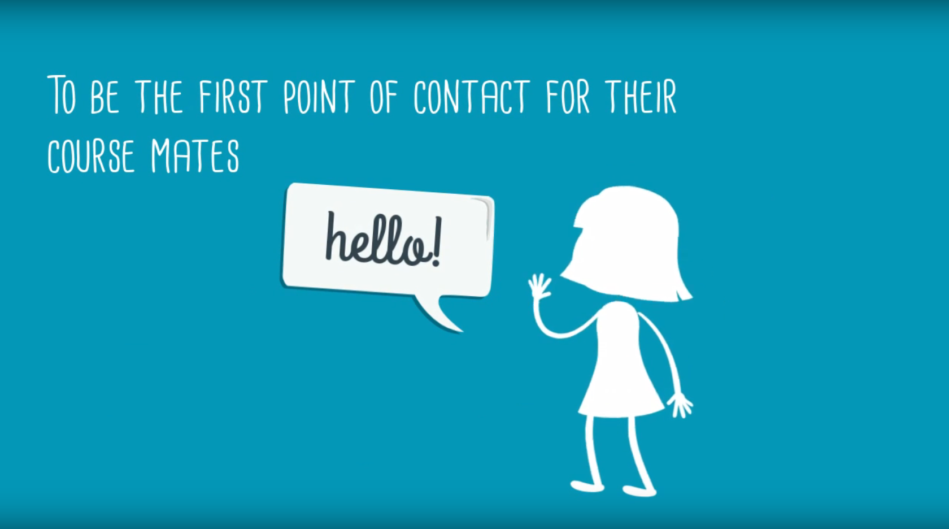

Slide 10
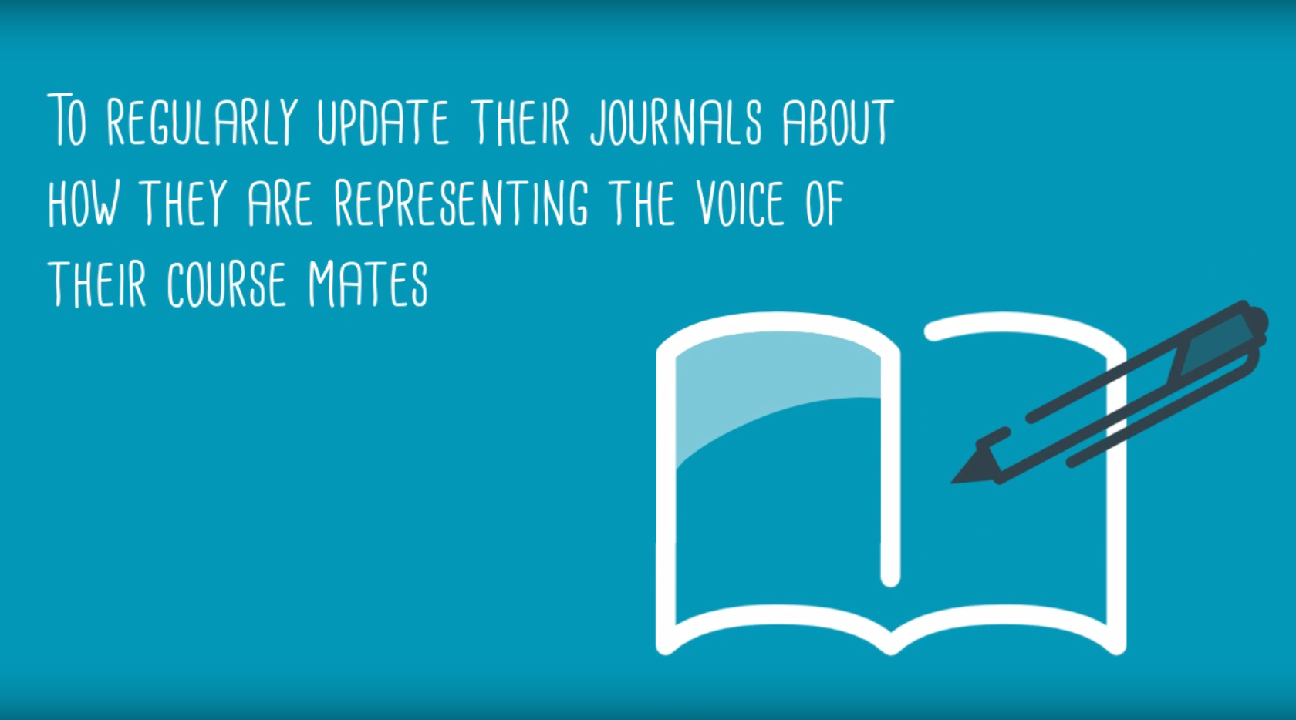

Slide 11
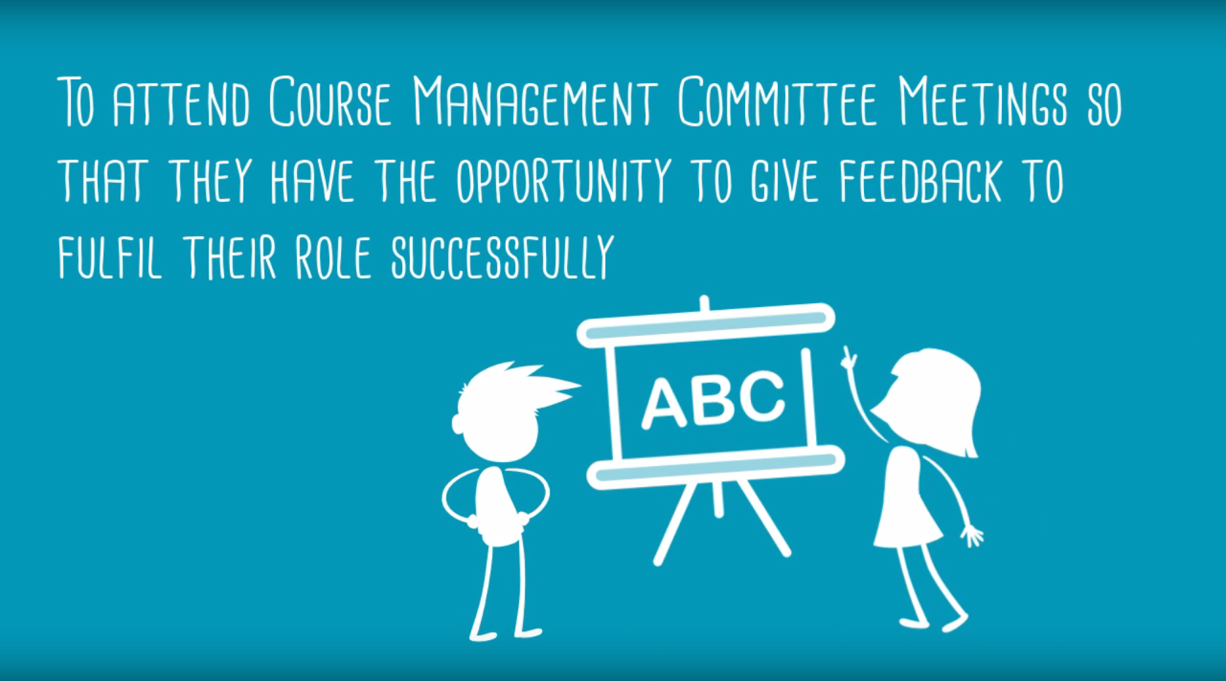
STUDENT –STAFF LIAISON COMMITTEE MEETINGS

Slide 12
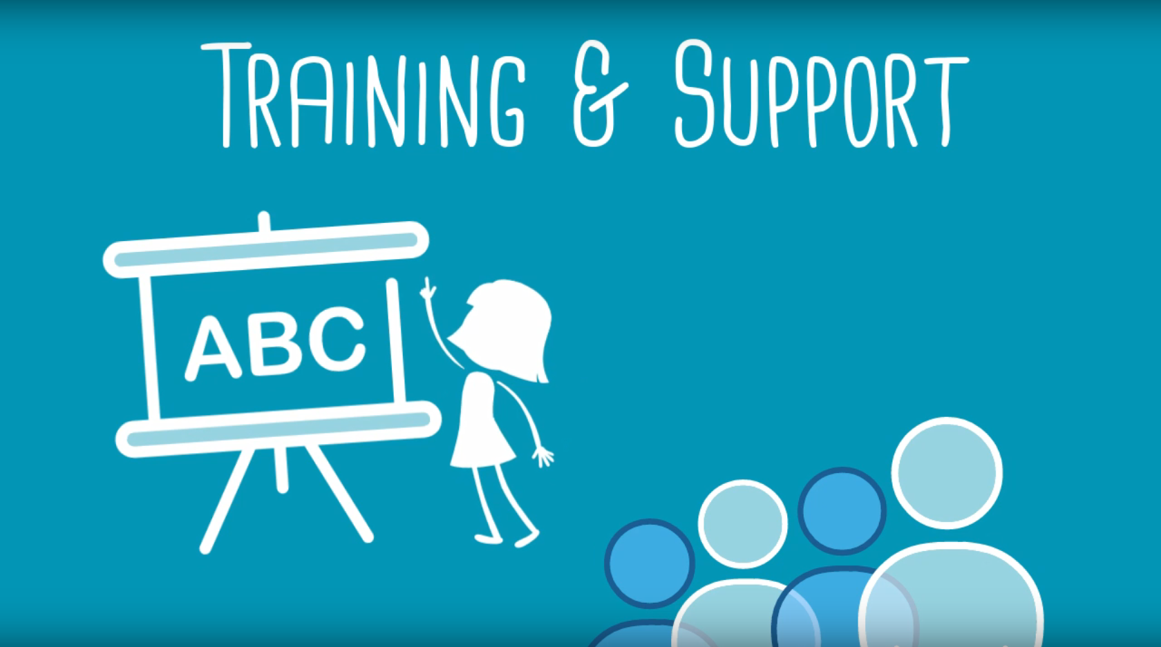
Training is provided for all Reps by the SU

Slide 13
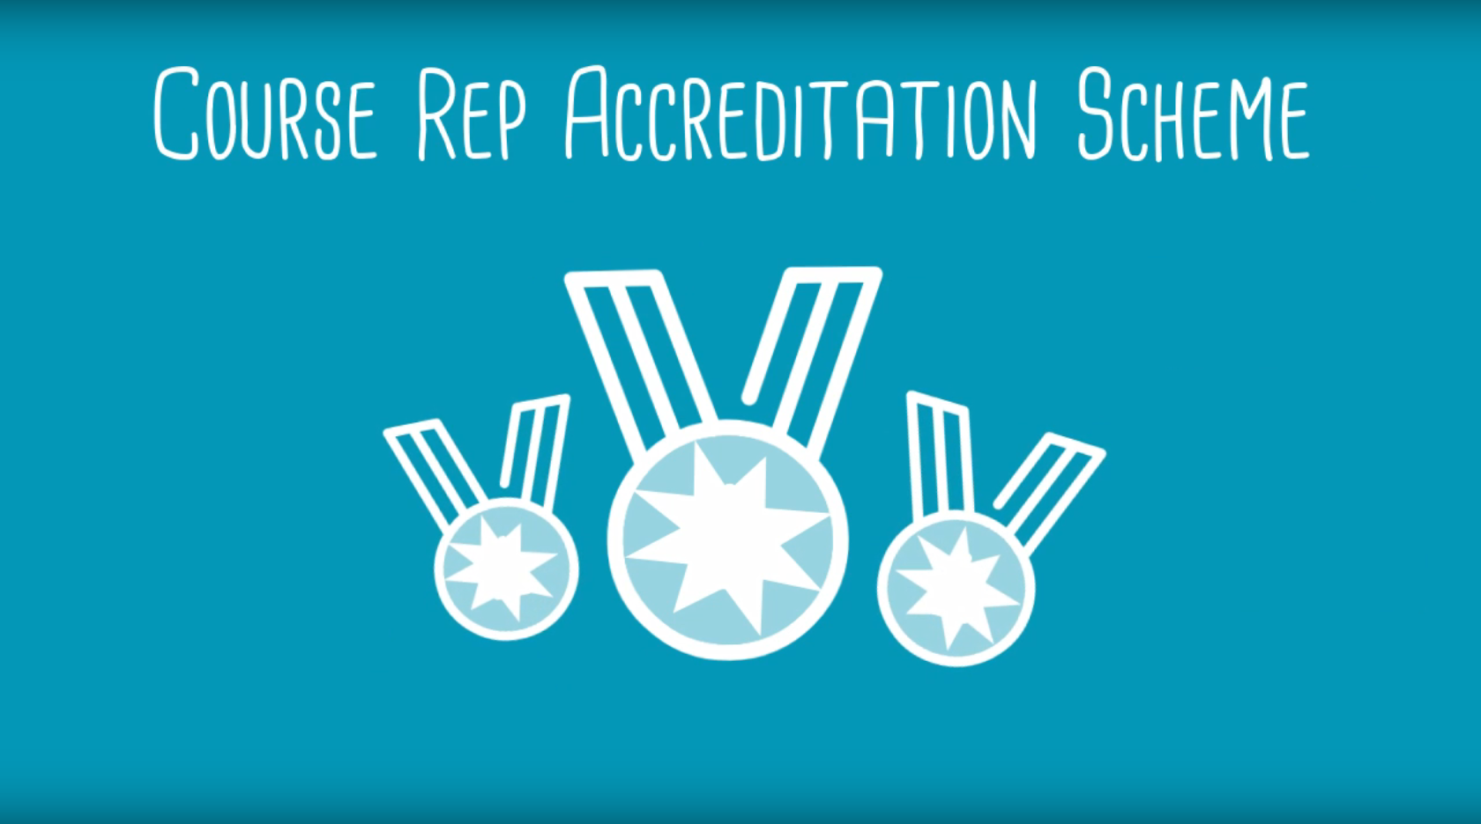
The SU also has a Course Rep Accreditation Scheme. This is the chance for Reps to get recognised for all their hard work. For more information about the scheme and how to get accredited, you can visit our website.

Slide 14
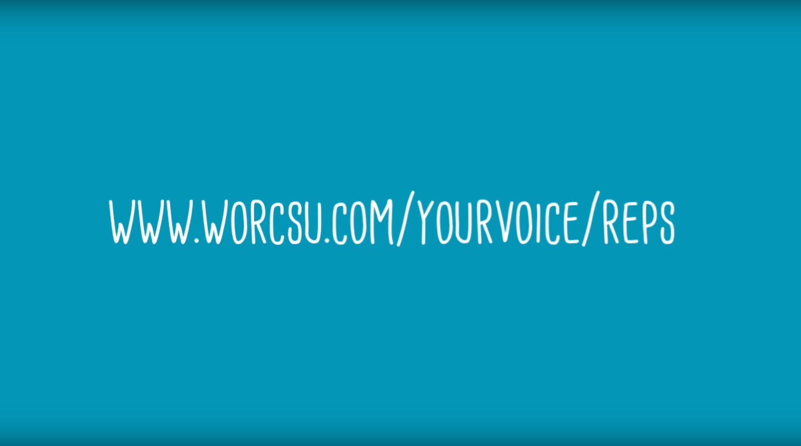
If you are interested in making a difference and representing the voice of your course mates, just let your Course Leader know that you would like to become a Course Rep. or, find out more on our website.
Or get in contact with Ragnar Mularczyk– Vice President Education r.mularczyk@worc.ac.uk
or Jack Appleby - Student Voice Assistant j.appleby@worc.ac.uk

