Slide 1
Please keep camera’s and mic’s off (to save the internet) Please note: This session will be recorded.

Slide 2
Course Rep Training

Slide 3
What we will cover.
The who’s who?
What is a course rep?
What role does a course rep play?
What to do with feedback
Rep Journals
List of contacts

Slide 4
The who’s who?

Slide 5
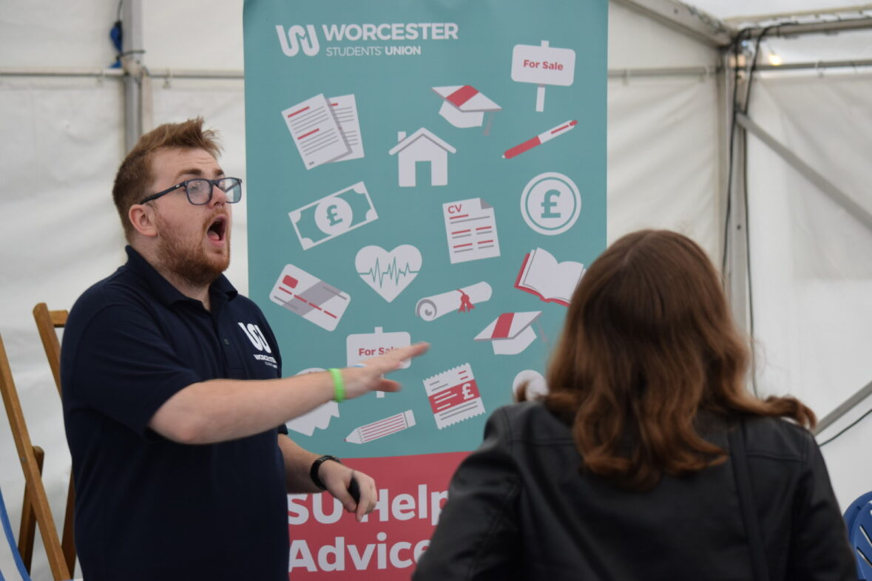
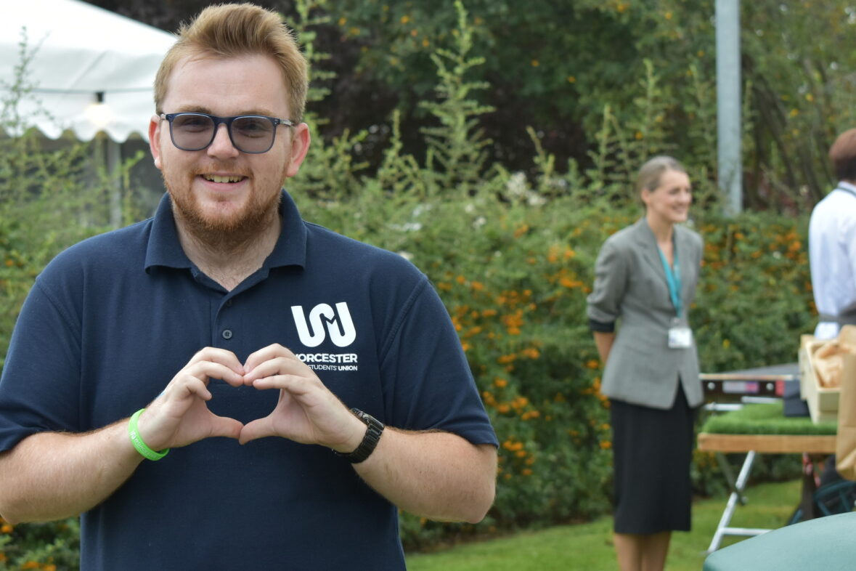
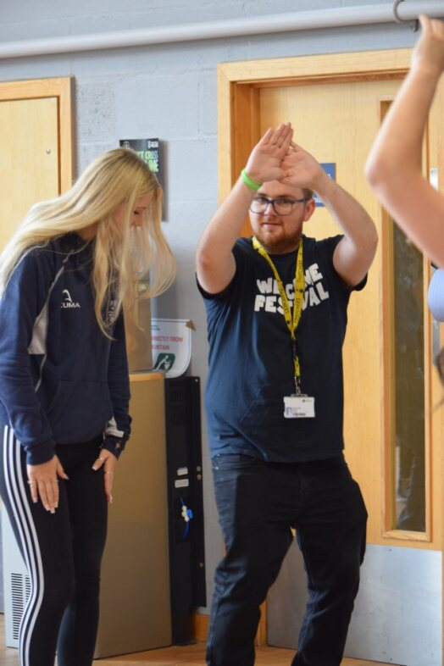
Seb James VPE

Slide 6
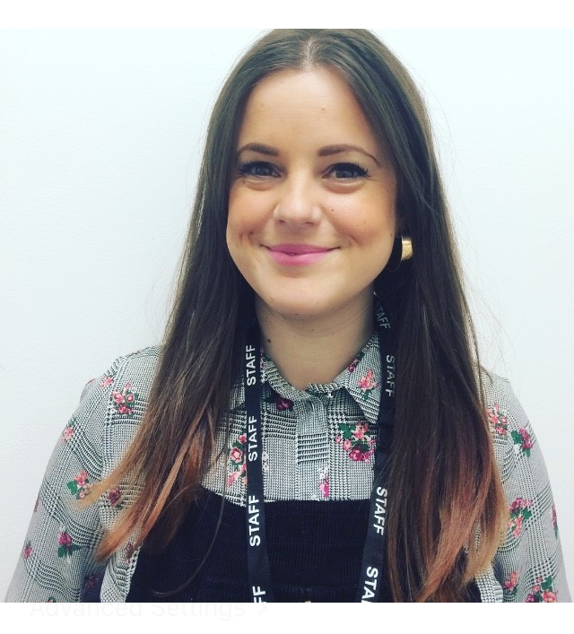
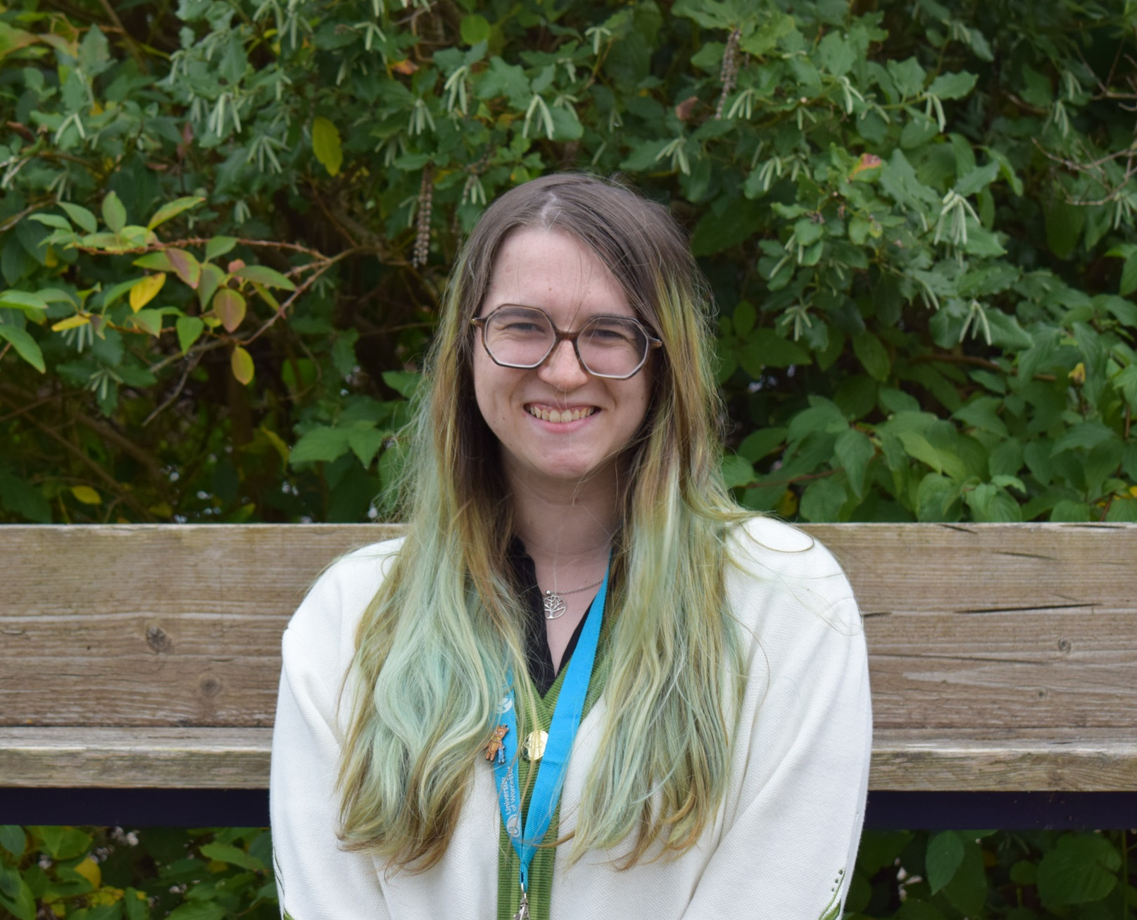
The Student’s union support team
Antonia Rossiter-Eaglesfield (She/Her) -
Director of Representation and Membership Services
Vic Presdee (They/Them) –
Student Voice Assistant.

Slide 7
Department Reps
Institute of Education
Primary Education – Ellie Harris (She/Her)
Secondary and Post Compulsory – Sarah Stanley (She/Her)
Education and Inclusion – Kristine Mendoza (She/Her)
Humanities
English, Media and Culture – Elliot Atkinson (He/Him)
History, Politics and Sociology – Harry Mellor (He/Him)
Law – Caysee Webster-Miles (He/Him)

Slide 8
Department Reps
Allied Health and the Community
Occupational Therapy, Physiotherapy and Nutritional Therapy – Oliver Nightengale (He/Him)
Health and Wellbeing – Hannah Harrison (She/Her)
Social Work and the Community – Alice Mills-Adams (She/Her)
Paramedics and Physicians Associates – Katherine Stone (She/Her)
Nursing and Midwifery
Nursing Associates and Apprentices – Vimal Vinay (He/Him)
Pre-Registration Nursing – Swathi Suresh (She/Her)

Slide 9
Department Reps
Science and the Environment
Biological Science – Jack Edwards (He/Him)
Worcester Business School
Computing – Connor Hay (He/Him)
Management and Finance – Anesse Ameer (He/Him)
Psychology
Performance, Health and Wellbeing – Samantha Ayettey (She/Her)
Sport and Exercise Science
PE and Coaching – Nathan Charles (He/Him)

Slide 10
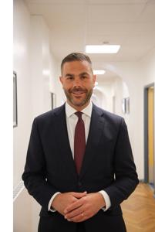
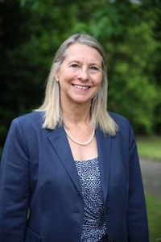
The University

Slide 11
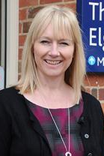
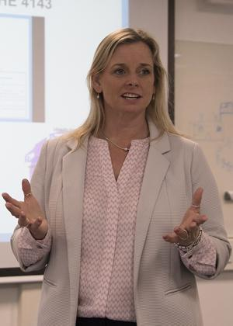
College Directors

Slide 12
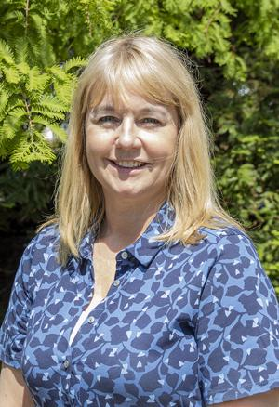
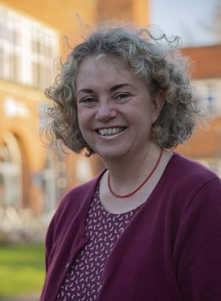
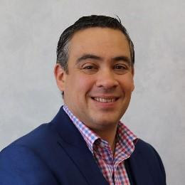
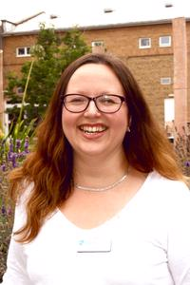
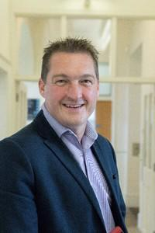
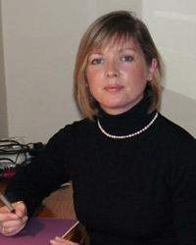
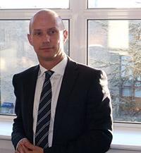
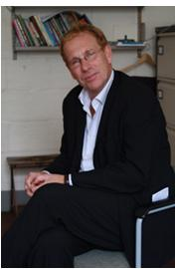
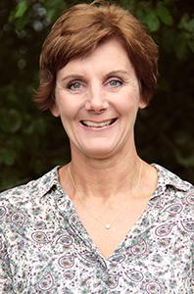
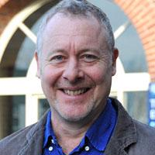
Heads of School

Slide 13
University “Buzz words”

Slide 14
We love a buzz word at universities, here are some of the most common
Uni talk
Real talk
Level
Cohort
PAT
SSLC
Your year group
Your course group
Personal Academic Tutor
Student Staff Liaison Committee

Slide 15
What is a course rep?

Slide 16
What is a course rep?
A Champion of your course
A way for students to have their voices heard
A friendly and welcoming face
Someone the course staff can talk to
Ultimately the most essential tool in the feedback mechanism

Slide 17
1 VPE
24 Department Reps
Over 400 Course Reps
Notes:
So as you can see theres a lot more of you than there is of me, and that’s why I need your help!

Slide 18
What isn’t a course rep
You’re not the solution to all problems
You’re not paid (sorry!)
You’re not the mouth piece of lecturers/staff
You’re not the only ones who can feedback
You’re not just a tickbox!

Slide 19
What role does a course rep play?
You meet with your cohort and gather feedback/concerns
Attend SSLC’s on a semi-regular basis
Chat to the VPE and SU team about what's happening
Provide updates to cohort over where feedback has gone
Promote surveys and department opportnities

Slide 20
Feedback

Slide 21
‘the transmission of evaluative or corrective information about an action, event, or process to the original or controlling source’
We talk a lot about feedback but here’s one definition of it

Slide 22
What ways can we gather feedback?
Social Media
Pen and Paper
Verbal
Email
Lecturer’s or Staff
Student Union

Slide 23
Now we have our feedback what can we do?
Talk to another Course Rep
Speak to your course leader (email or verbally)
Talk to the VPE for signposting or support
If appropriate talk to the cohort
Raise at an SSLC

Slide 24
Really important to share results or outcomes with fellow students

Slide 25
Things to remember
Lecturer’s will teach on multiple courses, give them enough time to respond
If 5 working days have passed, send a gentle reminder to lecturers
Lecturer’s may not be able to solve everything
Your SU is here for you, let us know if you need support
You have Department Reps, feel free to contact them for wider support

Slide 26
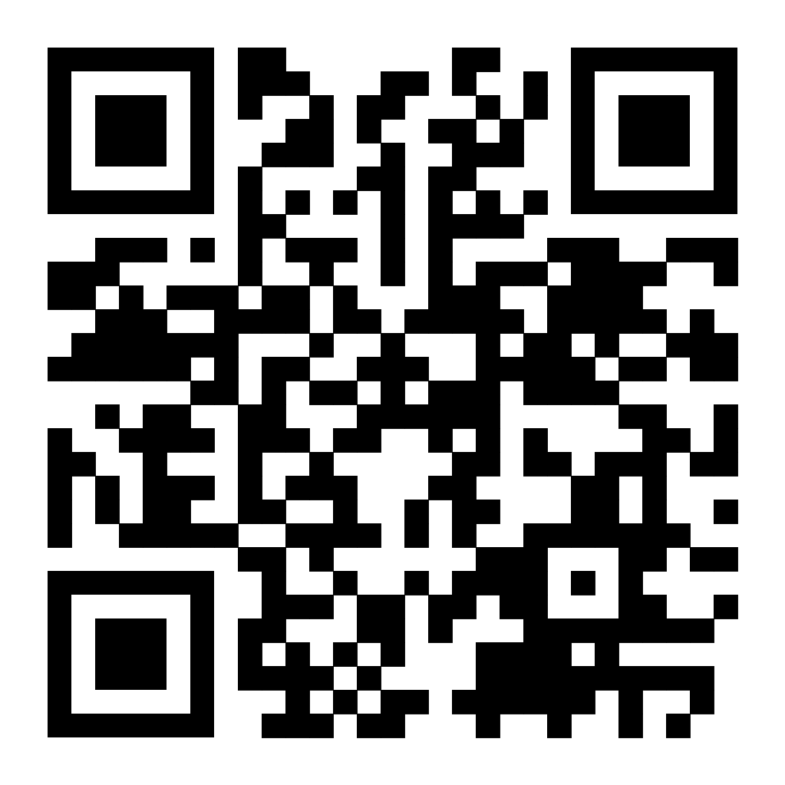
Rep Journals
Rep Journals are an electronic diary of activities
Let’s the SU know what is happening
Keeps an eye on trends
Works towards rep rewards
Gives the VPE an opportunity to support students where needed

Slide 27
Rep Rewards
Each year we hold a rep celebration
Rep of the Month
Rep of the year

Slide 28
The year ahead
Rep Conference – Jan 26th
Elections – 26th Jan – 1st Feb
All Student meeting – Jan 23rd
Rep Forum 1 – 16th November
Rep Forum 2 – 13th March

Slide 29
Contacts
Seb - Vice President Education
sebastian.james@worc.ac.uk working hours 09:00 – 17:00 M-F
@sebvpe23 – Instagram
Sebastian James – Teams
Vic – Student Voice Assistant
v.presdee@worc.ac.uk working hours 08:30 – 16:30 M-F

Slide 30
Any Questions?

