Slide 1
Making your Committee Work

Slide 2
What is a Group?
“a number of people or things that are located, gathered, or classed together”

Slide 3
What is a Committee?
A committee is a group of people who take on the responsibility of managing and representing a group, voluntary organisation, charity, trust or social enterprise

Slide 4
What does a Sports Club Committee do?
Has a shared sense of purpose (following aims & objectives)
Provides direction and leadership
Takes collective responsibility
Complies with WSU Rules and Regulations
Ensures the continued sustainability of the sports club
Represents the sports club within the WSU/University
Ensures effective communication/promotion to the student body

Slide 5
What makes a Good Sports Club Committee?
Committee members who understand their responsibilities and role
Having the right mixture of skills, abilities and experience around the table
Commitment to the role and the aims and objectives of the sports club
Works as a team and gets stuff done
Understands and complies with WSU rules and regulations
Plans and sets goals effectively and implements plans
Received a good handover from the previous committee and is preparing their handover
Has regular and productive Committee meetings

Slide 6
Committee Meetings
Committees have meetings to:
Make decisions regarding the sports club’s activities
Update each other with what you have been doing
Review actions and plan for future activities
Delegate and agree actions
Discuss and resolve any issues

Slide 7
Arranging a Meeting
Chair
Secretary
Set the agenda
Delegate tasks to the Secretary
Ensure they understand all of the agenda items
Book/arrange the venue
Invite all attendees
Send out agenda for feedback
Write up and distribute the previous minutes

Slide 8
Meeting Agenda
Provides structure to the meeting
Is set by the Chair
Think about date, time and venue
Should be sent out at least a week before the meeting for feedback
Any other business (AOB) to help to keep the meeting on track
Don’t forget to number each agenda item

Slide 9
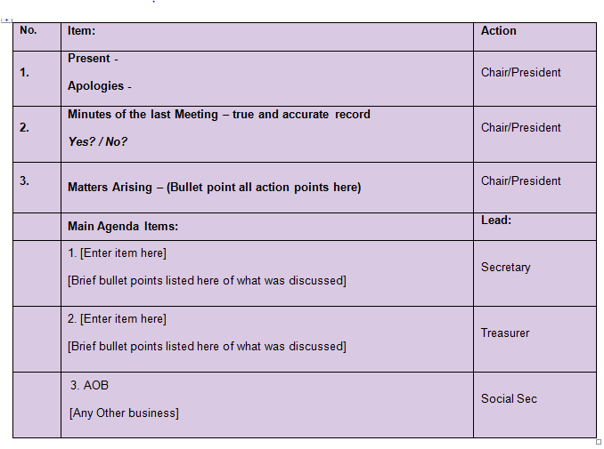
Taking Minutes
Note date and time
Record those present/absent
Follow the agenda
Sit next to the chair of meeting
Must be an overview of the items discussed and clearly state who is responsible for any actions and their deadline
Always try and write up your minutes as soon as possible (and send to SU)

Slide 10
Committee Meeting Video
Barriers to effective meetings

Slide 11
Let’s Review
How does the chair act?
What do they do well? What doesn’t go so well?
Does the group solve the issue? If not why not?
What could be done to make the meeting run more smoothly?
Who in the group does not act professionally and why?

Slide 12
Committee Meeting Video 2
A more effective meeting

Slide 13
Let’s Review
How does the chair act differently
What do they do well? What doesn’t go so well?
How was this meeting better?

Slide 14
Conclusions
An effective committee=an effective sports club
The Committee meeting is the key tool for creating an effective committee
Quality agendas and minutes=effective meetings
Professionalism is key

