Slide 1
Fundraising for Charity and your Club/Society
Eleanor & Lyndsey

Slide 2
Aims of the session
To understand why you should fundraise
To understand what is Rag and how you can get involved
To understand charity legislation and it’s importance
To understand the different events you can plan and how to do it

Slide 3
Fundraising

Slide 4
Fundraising
Fundraising is the way in which charities ask for donations or financial support.
Fundraising is the main way that people hear about the work of charities and get involved.

Slide 5
Why fundraise?
Raise money for your club/society to fund your activities throughout the year
Raise money for a good cause
You could be up for fundraiser of the year during Celebration Week.
By fundraising you are raising awareness for a cause
It makes you feel good

Slide 6
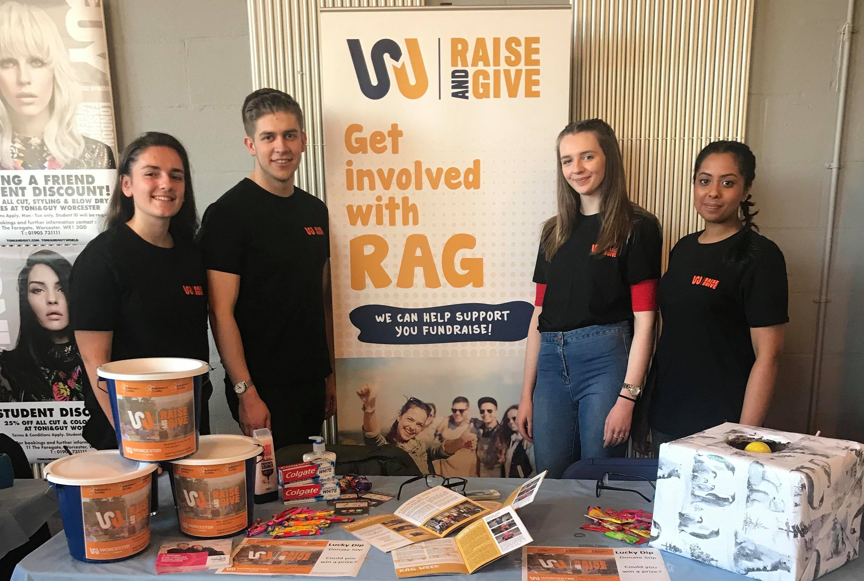
RAG What is it?

Slide 7
What is RAG?
RAG stands for 'Raise and Give'
RAG is run by a Student Committee who spends time organising fundraising events and other activities to raise money for nominated Charities.

Slide 8
Charities
RAG’s focused charity for the year as chosen by the students. BUT we can raise money for any registered Charity and support students to do so.

Slide 9
RAG Week
When: 12th November – 16th November
Why: To fundraise for WMRSASC
How: Get involved by taking part in one of the events or by running your own.

Slide 10
Charity Legislation

Slide 11
All Fundraising in the SU is...

Slide 12
This means…
RAG logo has to be on all publicity
A sports club you are working ‘in association with RAG’
RAG & the SU need to know about it before the event is publicised/happens
RAG committee needs to know if it clashes with any of their events
RAG & the SU need to know the total amount raised
Money needs to be paid into the RAG account

Slide 13
Charity Legislation
Take Responsibility for your fundraising. – Be clear and truthful
There are standards to follow in how you ask for money, and a system to investigate complaints from the public about fundraising.
It’s really important that you know what the rules are so that you can make sure you always fundraise the right way.
Handling donations safely and securely
Honouring your promises to supporters
Taking responsibility for your fundraising
Treating the public fairly and with respect
Being clear and truthful
As Worcester Students’ Union is a UK registered charity it is subject to legislation contained in the Charities Act, this means that all charity fundraising must go through the RAG account due to rules around one charity donating to another charity.

Slide 14
Other legal requirements
What % of money taken will go to charity
Have the charities registration number displayed - you can only raise for registered charities

Slide 15
Code of Conduct
Do not smoke, drink take drugs while representing a charity
Do not dress inappropriately
Do not act in a vulgar, abusive or in an aggressive manner
Do not Exploit their position
Do not guilt people into donating because ‘it’s for charity’
Do not do anything that will make anyone in the vicinity anxious
Be open and honest at all times
Ensure that you have the correct permissions and paperwork including risk assessments and insurance
Do not be misleading in anyway

Slide 16
Planning an Innovative Event
NO BAKE SALES

Slide 17
Activity
You have 10 minutes to come up with as many innovative Fundraising events for either your club/society or for charity.
Now pick one of those ideas and plan the fundraiser. Provide as much detail as you can

Slide 18
“Unique, fun and often mischievous”
The opportunities for creative fundraising ideas are endless
We want to support you to fundraise safely, have fun and raise awareness for good causes (where applicable).

Slide 19
What you need to know
Think of a fundraising idea – think outside the box
Book a bucket and set up any online fundraising links
Promotion – have the correct information
Fill out the relevant forms
LET THE SU AND RAG COMMITTEE KNOW!

Slide 20
Summary
Fundraising is the way in which charities ask for donations and raise awareness
You should get involved with RAG in any way you can
Remember not to shake the buckets and that charity legislation is really important
Don’t do a cake sale, stand out and use the event ideas to come up with something different. You want to be unique with your fundraising.
The SU and RAG are here to support you so use us!

