Slide 2
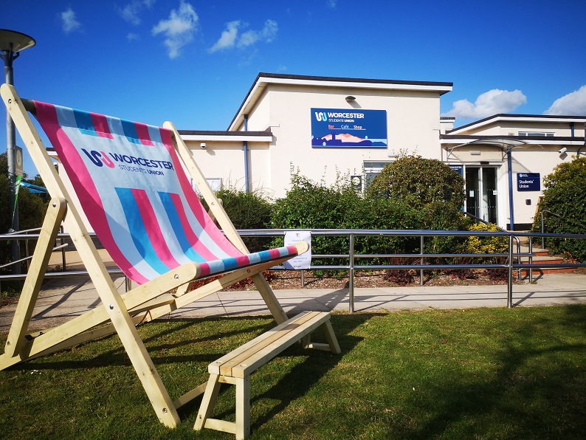
Who are we?
The SU is here to represent all students at the University of Worcester. All students at Worcester have a say in how we’re run.
SU President – Liam Lees
VP Education – Ragnar Mularczyk
VP Student Activities – Neve Ricketts

Slide 3
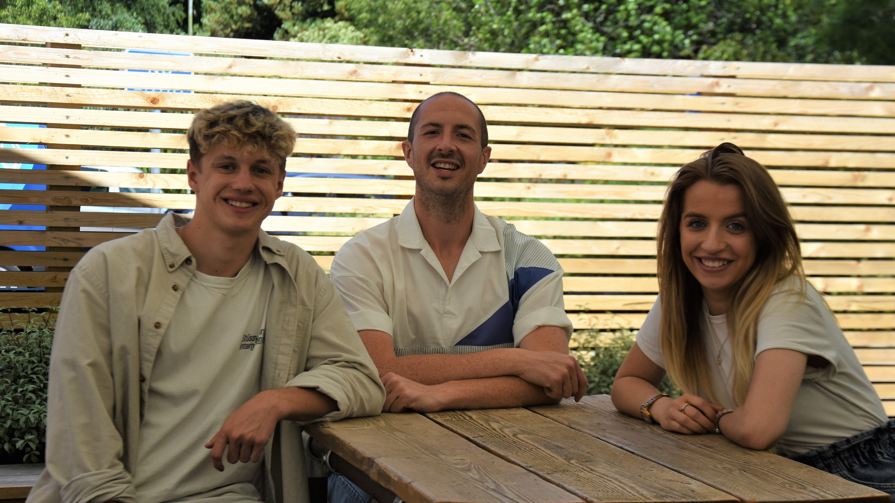
Representation – Full Time Officers
Elections for Full-Time Officers take place every March.
Officers are voted for by you, to represent you and give you a voice at the University.
Each Officer has a different
area of responsibility.
Officers run various campaigns
and events throughout the year,
so keep an eye on social media
for regular updates.

Slide 4
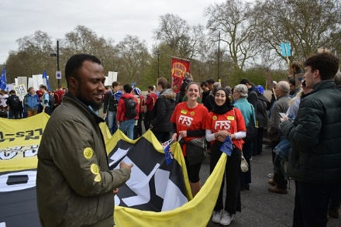
Representation – Networks
Networks represent the interests of students from certain groups and on the issues most important to you.
BAME Network – Commuter Network
Disabled Students’ Network
International Network – LGBTQ+ Network
Mature Students’ Network
Postgraduate Network – Sustainability Network
Widening Participation Network Women’s Network
Networks work to design and deliver
campaigns that drive forward welfare,
inclusion, diversity, and equality.

Slide 5
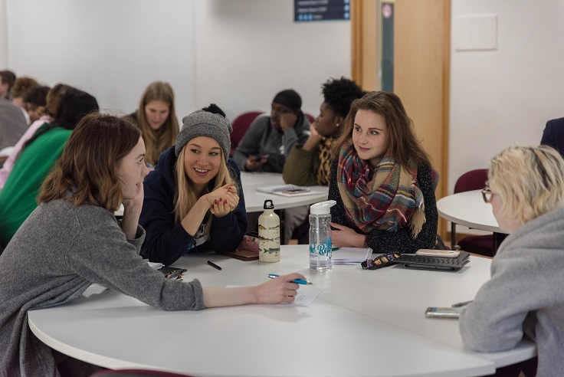
Representation – Academic Reps
We work with the University, Course Reps, School Reps, and the VP Education to make your academic experience the best it can be.
You’ll have at least one Course Rep
to represent your views on your
course – make sure you give them
feedback throughout the year.
If you want to get involved and
become a Rep, speak to Rag or
have a chat with your course leader.

Slide 6
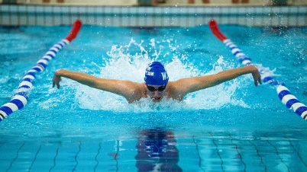
#TeamWorc – Clubs
We have a wide range of sports Clubs with more than 40 teams competing nationally in BUCS.
Clubs are run by student-led committees and are open for any University of Worcester student to join.
This year we’re offering discounted
memberships for students on placements.
Each year we compete in Varsity
against the University of Gloucestershire.

Slide 7
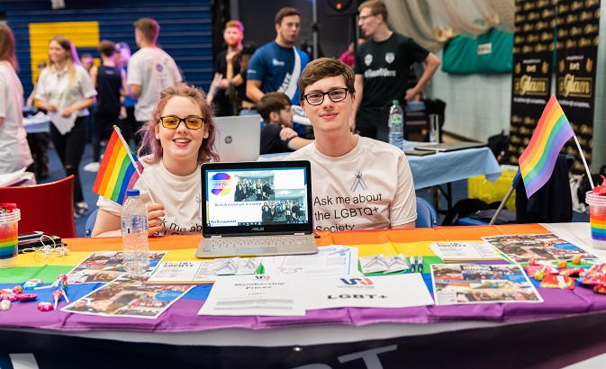
#TeamWorc – Societies
We currently have more than 30 Societies.
General interest Societies range from Loco Show Co to Harry Potter to Christian Union to everything in between.
We have a number of cultural societies to represent various student groups and interests.
And you can also join academic
societies to enhance the learning
experience on your course.
Set up your own society –
visit www.worcsu.com/societies

Slide 8
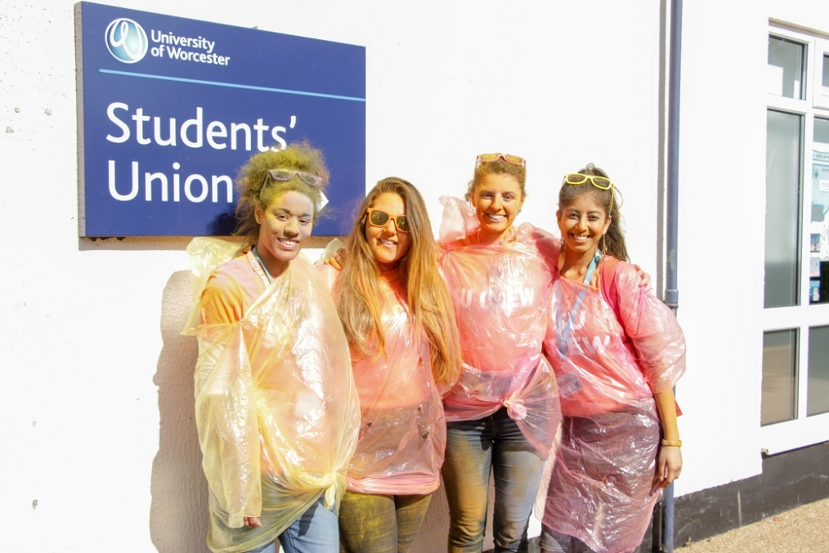
#TeamWorc – TeamWorc Action
TeamWorc Action is all about the volunteering opportunities available to you at the University and in the local community.
Record over 50 hours of volunteering
and it will be officially recognised
on your degree transcript.
Visit our website to find
volunteering opportunities and
everything else you need to know
about TeamWorc Action.

Slide 9
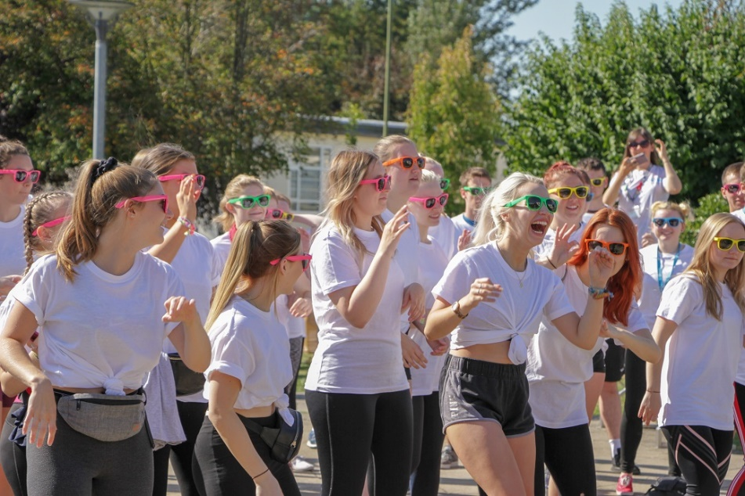
#TeamWorc – Raise and Give (RAG)
RAG gives you the opportunity to fundraise for the charity of your choice.
Our official RAG Charity for 2021-22 is Student Minds.
The SU and student-led RAG
Committee can help you set up
your fundraising event.
Last year our students raised
over £32,000 for charity.

Slide 10
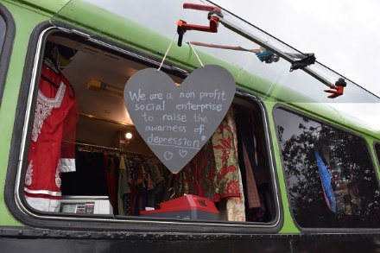
Help and Advice
We offer confidential and independent advice to all students at Worcester and its Partner Institutions.
Appeals, complaints, disciplinaries, fitness to practise, accommodation.
Phone and Microsoft Teams
meetings are all available.
Book through the advice form at www.worcsu.com/helpandadvice

Slide 11
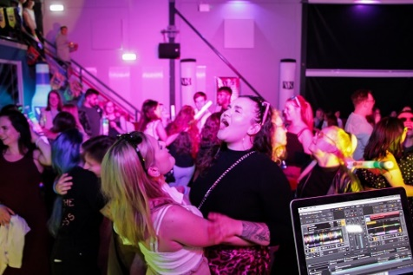
The Hangar
Your student bar on campus.
Regular weekly events like Quiz Night and Worcester Wednesday.
Big events like Disco Binglow,
Karaoke specials, Varsity Afterparty,
and Dissy Day Party.
Cocktails, mocktails, VKs,
slushies, and Dark Fruit!

Slide 12
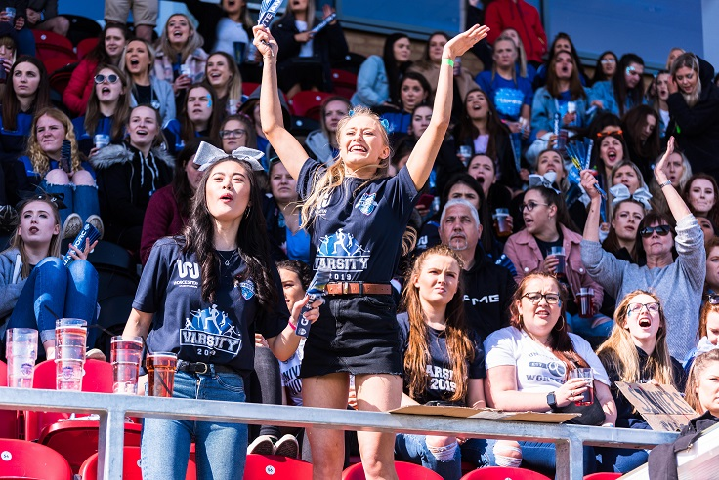
Events to look out for
Welcome Week
Club and Society ‘Give it a Go’ sessions
Halloween Karaoke and Scarefest
RAG Week
Christmas Karaoke
Refreshers Week
Officer Elections
Varsity
Dissy Day Party
Celebration Week

Slide 13
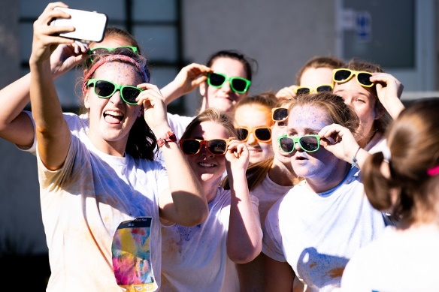
Keep in touch with the SU
www.facebook.com/worcsu
www.facebook.com/TheHangarSU
www.facebook.com/wsu.teamworc
www.twitter.com/worcsu
www.instagram.com/worcsu
www.instagram.com/the_hangar_
www.worcsu.com

Slide 14
Keep in touch with your Officers
Liam
@liamleespres
liam.lees2@worc.ac.uk
Rag
@ragvpe
r.mularczyk@worc.ac.uk
Neve
@nevevpsa
n.ricketts@worc.ac.uk

